Slide 1


HPC and AI convergence
An example from High Energy Physics
Sofia Vallecorsa
Frankfurt- 19/06/2019

Slide 2
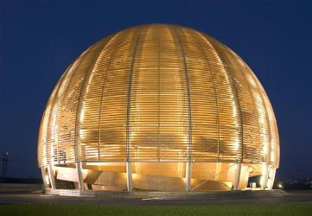
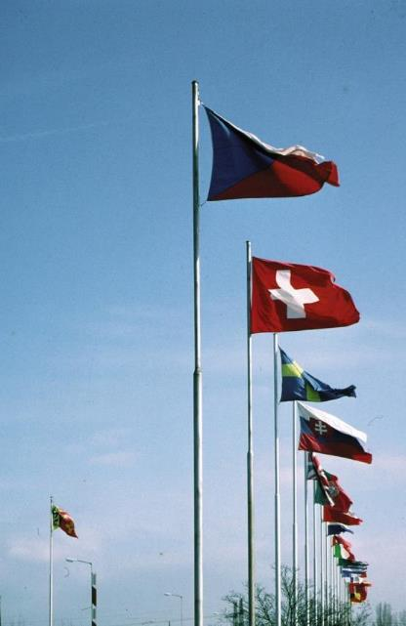
CERN
“Science for peace”
International organisation close to Geneva, straddling Swiss-French border, founded 1954
Facilities for fundamental research in particle physics
23 member states, 1.1 B CHF budget
3’197 staff, fellows, apprentices, …
13’128 associates
1954: 12 Member States
Members: Austria, Belgium, Bulgaria, Czech republic, Denmark, Finland, France, Germany, Greece, Hungary, Israel, Italy, Netherlands, Norway, Poland, Portugal, Slovak Republic, Spain, Serbia, Sweden, Switzerland, United Kingdom Candidate for membership: Cyprus, Slovenia
Associate members: India, Lithuania, Pakistan, Turkey, Ukraine
Observers: EC, Japan, JINR, Russia, UNESCO, United States of America
Numerous non-member states with collaboration agreements
2’531 staff members, 645 fellows, 21 apprentices
7’000 member states, 1’800 USA, 900 Russia, 270 Japan, …

Slide 3
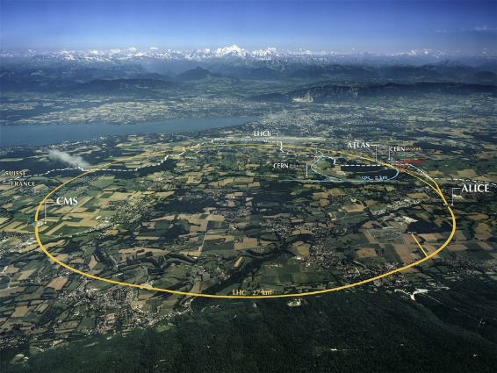
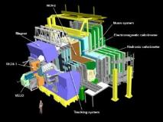
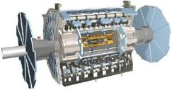
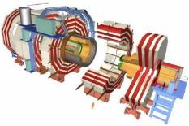
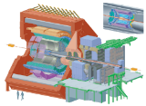
The Large Hadron Collider (LHC)

Slide 4
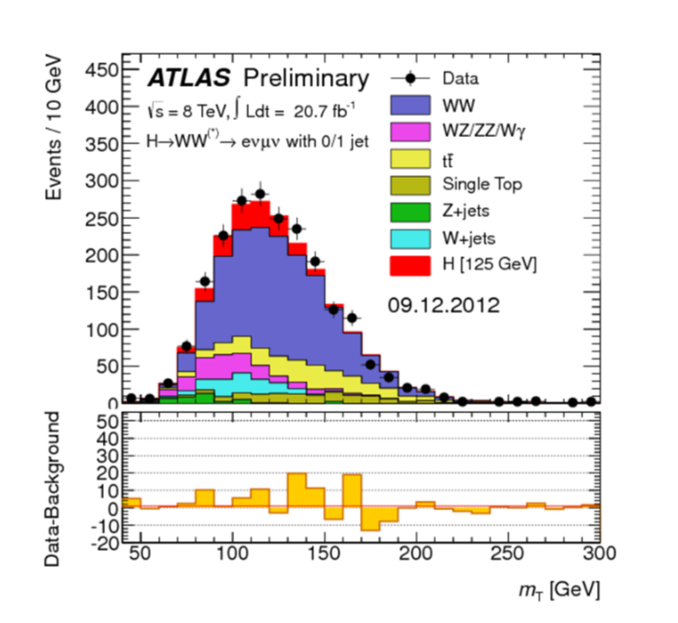
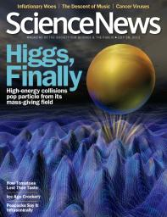
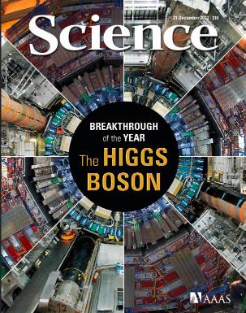

The Higgs Boson

Slide 5
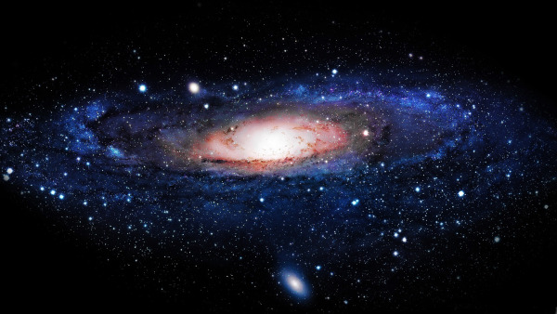
The Higgs Boson completes the Standard Model,
but the Model explains only about 5% of our Universe
What is the other 95% of the Universe made of?
How does gravity really works?
Why there is no antimatter in nature?

Slide 6
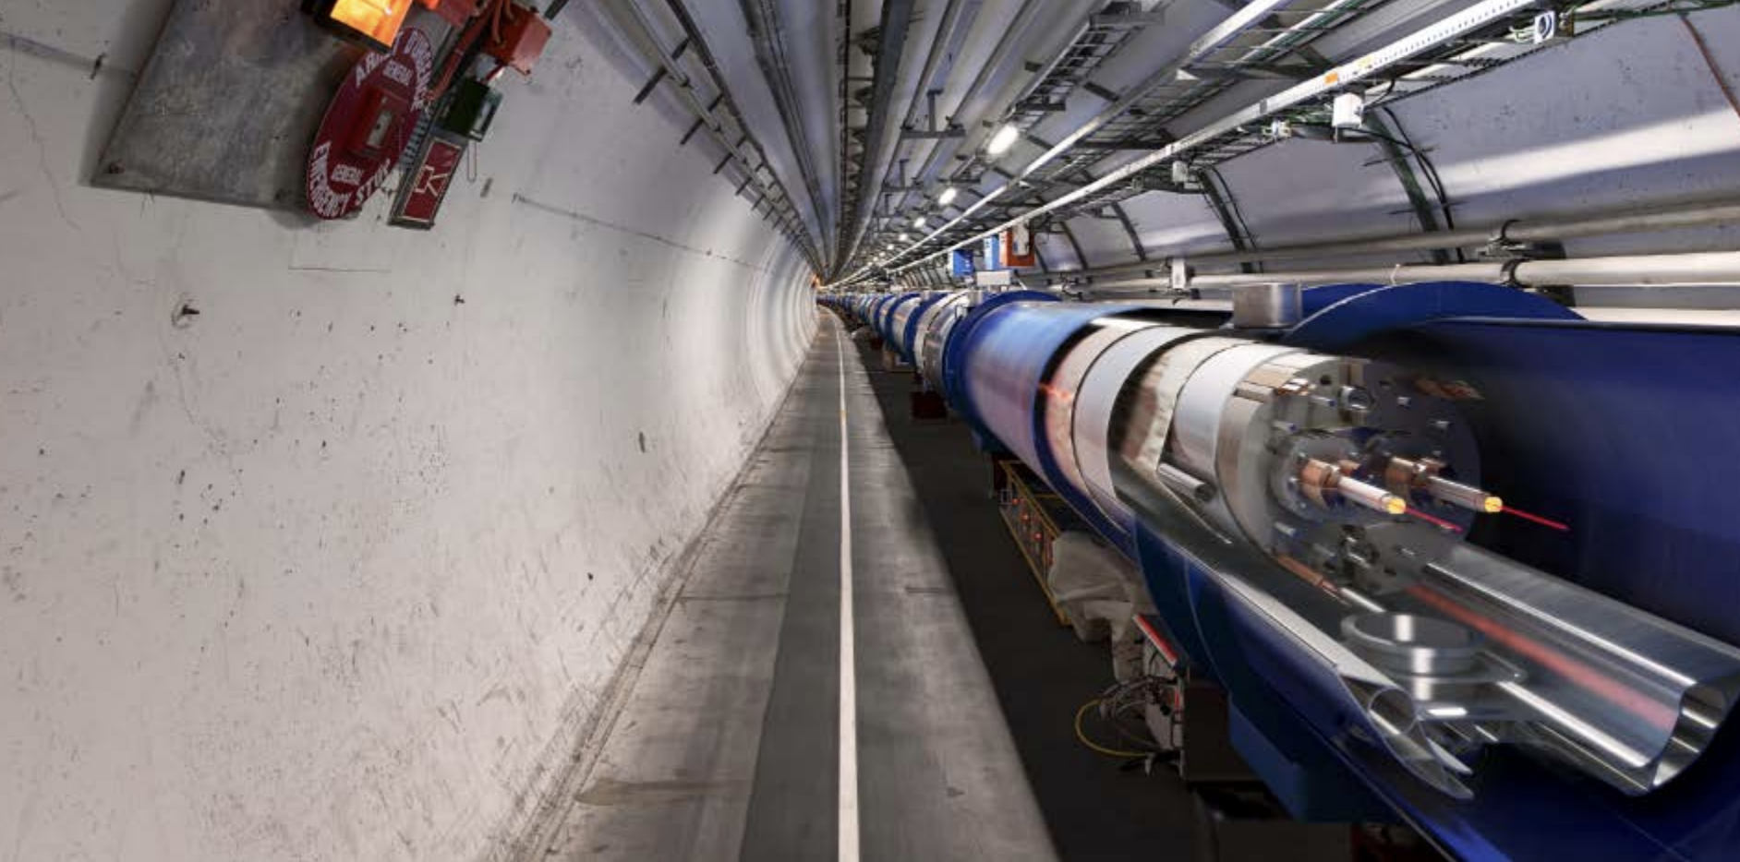
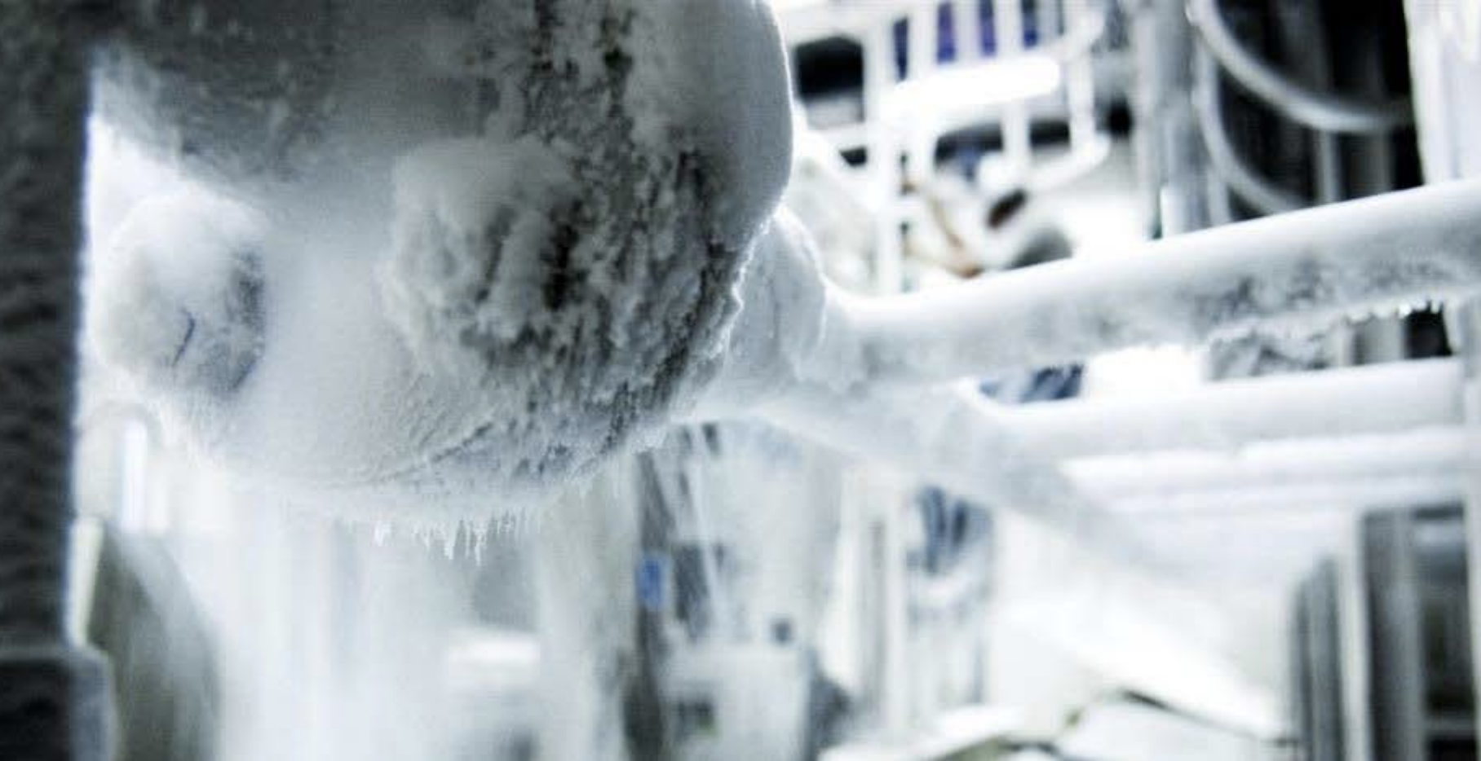
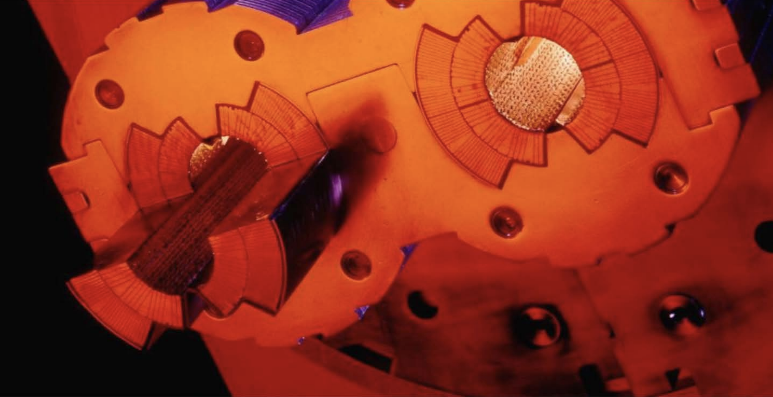
Why? …Big Data
LHC is entering the Big Data era
Accelerators infrastructure (control systems, monitoring )
9600 magnets for Beam Control
1232 superconducting dipoles for bending
Experiments (detectors & physics data)
330 PB of collisions data stored by December 2018
The computing infrastructure:
Large sets of metrics collected from system components (CPU and batch, disk and archive storage, network topology and flows, and application throughput)
LHC data represents a challenge since it is multi-structured, hybrid
Metadata
Databases Aggregation
Evolving Data model

Slide 7
From ridiculously difficult…
CMS simulation
...to almost impossible

Slide 8
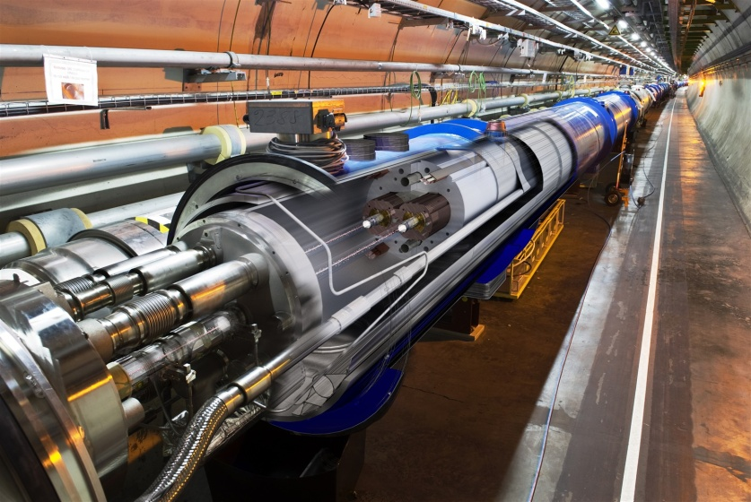
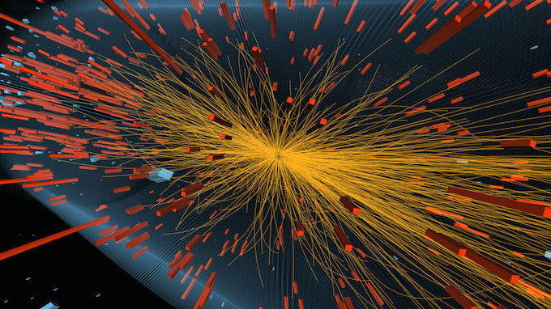
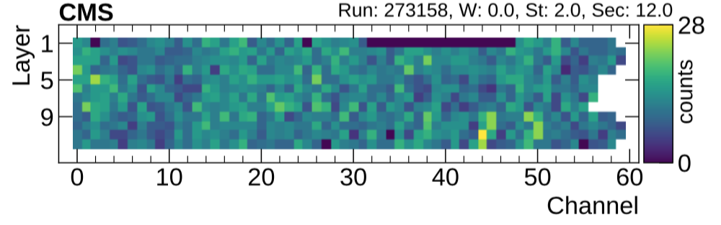
HPC and AI convergence in HEP
Deep Learning applications quickly multiply in High Energy Physics (HEP)
Extensive NN training will be a new workflow for large HEP experiments
Maximise performances
Fast turn-around for new trainings
Need dedicated hardware to be effective
HPC creates new AI models
Complicated network optimizations can have high computational cost
Train production-ready algorithms on HPC
Detector occupation map

Slide 9
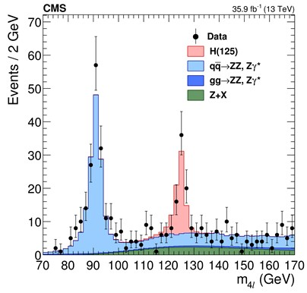

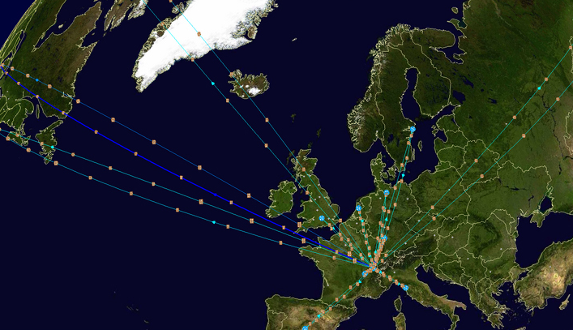
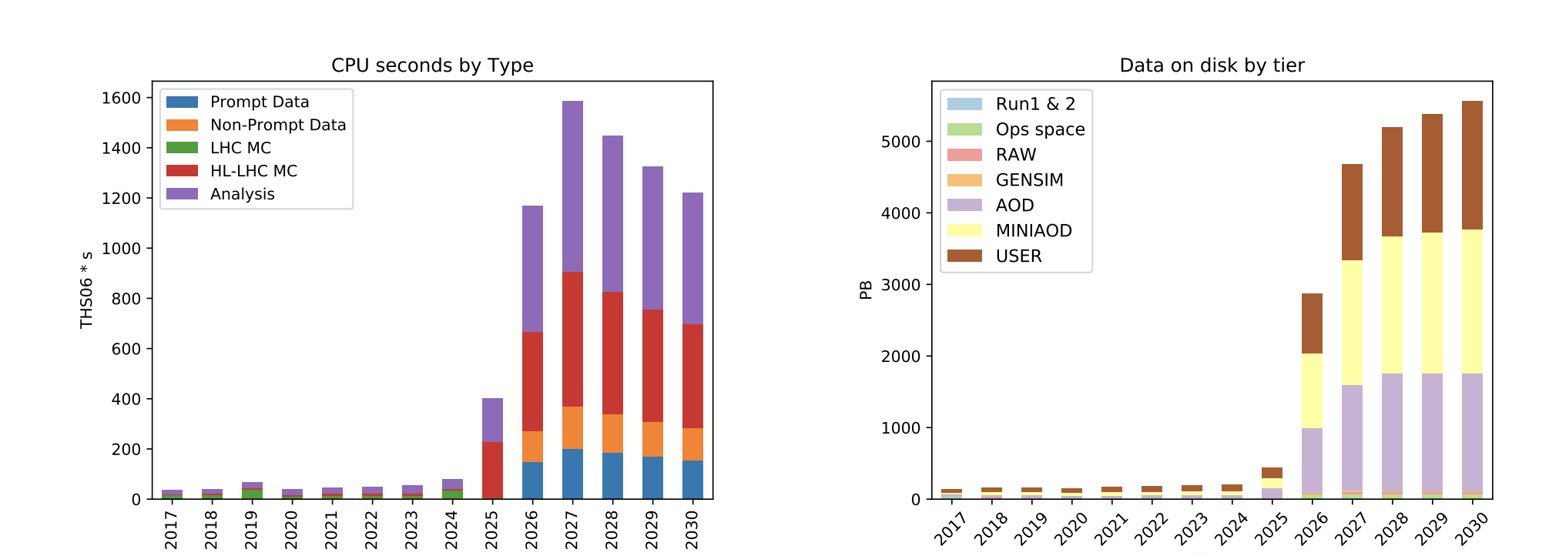
Monte Carlo Simulation
Essential for data analysis & detector design
Higgs boson
Understand how detector design affects measurements and physics
Correct for inefficiencies, inaccuracies, unknowns
Compare theory models to data
Complex physics and geometry modeling
>50% of Worldwide LHC Computing Grid (WLCG) power today
Increase by 100x by 2025!
CMS experiment
Flat Budget

Slide 10
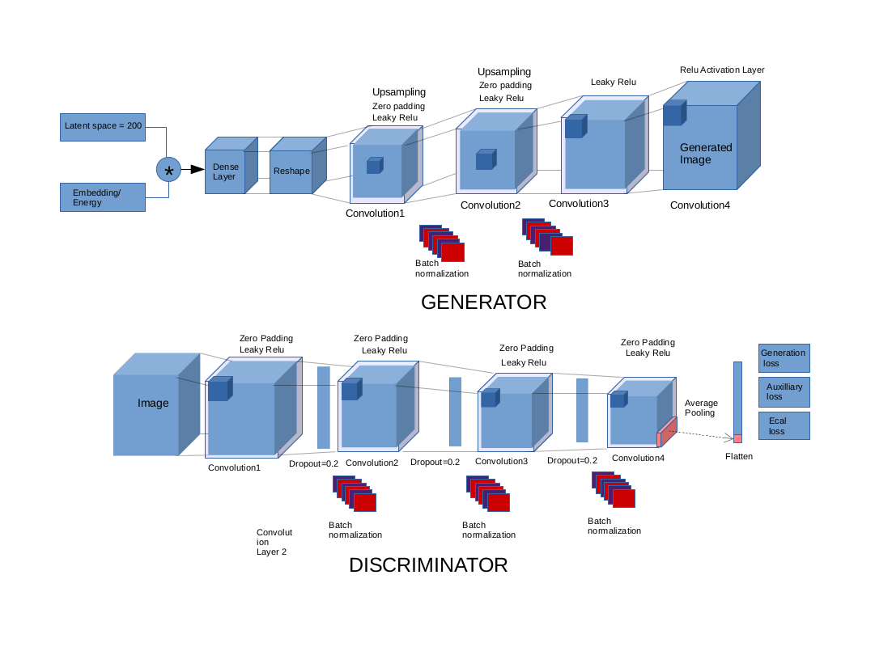
3D convolutional GAN
Generator
Discriminator
~1M parameters
Total model Size: 3.8MB

Slide 11
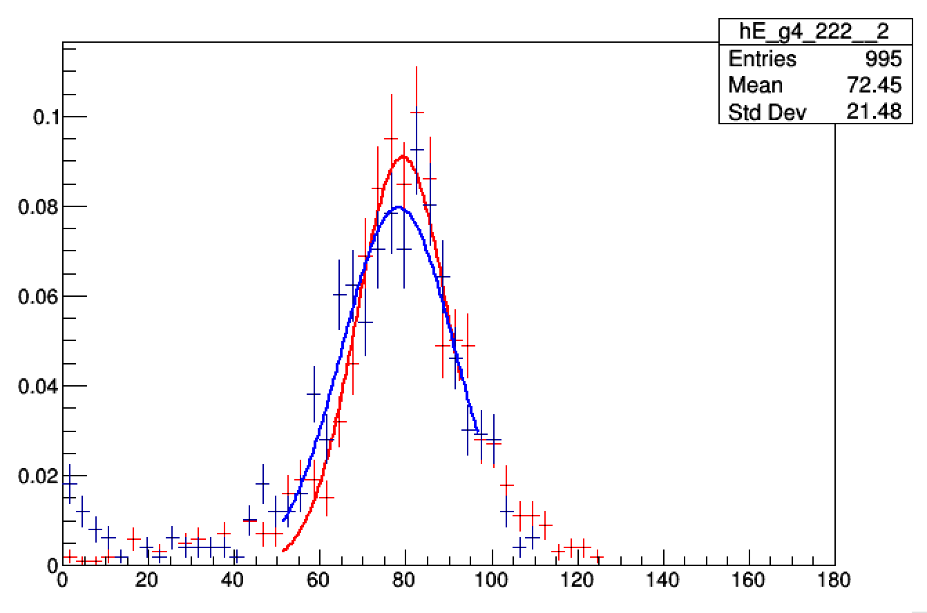
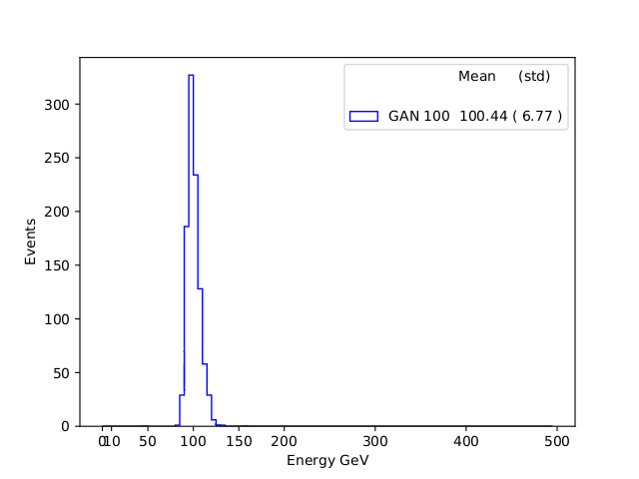
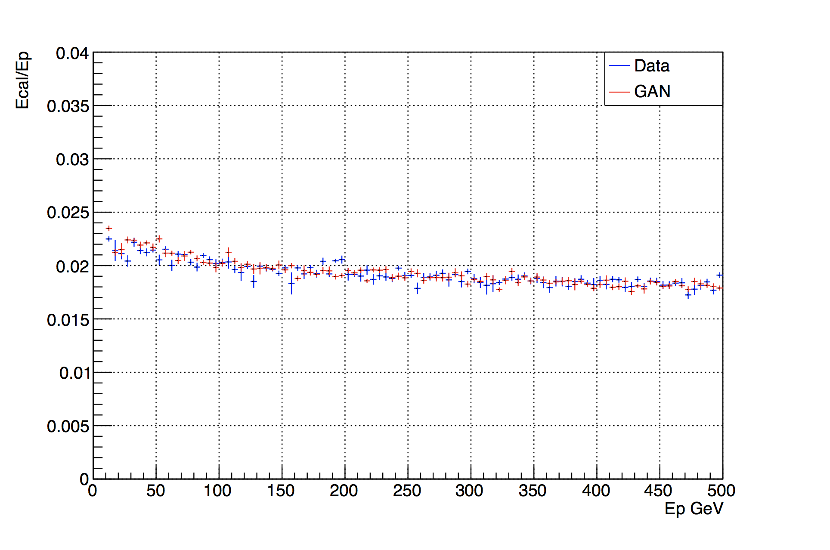
Physics results validation
Comparison to Monte Carlo data
Geant4
GAN generated
Single cell response
Primary particle energy
(100 GeV)
3D
Average shower section
GAN generated electron shower
Time to create an electron shower
Method | Machine | Time/Shower (msec)
MC Simulation (geant4) | Intel Xeon Platinum 8180 | 17000
3D GAN (batch size 128) | Intel Xeon Platinum 8180 | 7
Y moment (width)

Slide 12
Multi-Node Scaling Performance
Training Time/Epoch
94% scaling efficiency up to 128 nodes

